Slide 1
Appendix F
Derivation of a Schematic
for a DC Motor

Slide 2
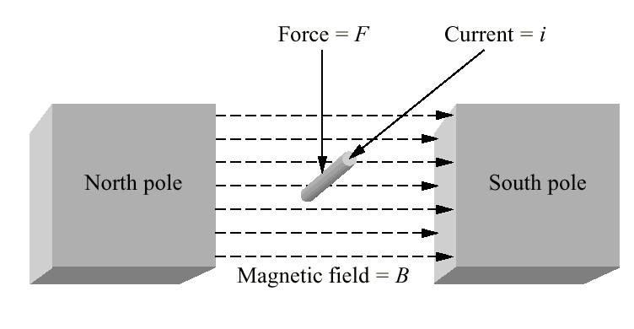
Figure F.1
Current-carrying wire
in a magnetic field

Slide 3
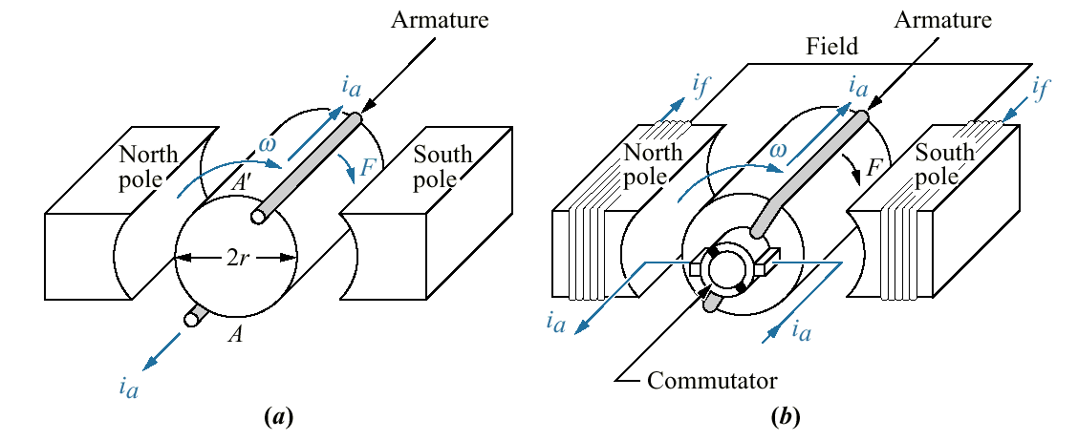
Figure F.2
a. Current-carrying
wire on a rotor;
b. current-carrying
wire on a rotor with
commutation and
coils added to the
permanent magnets
to increase magnetic
field strength

Slide 4
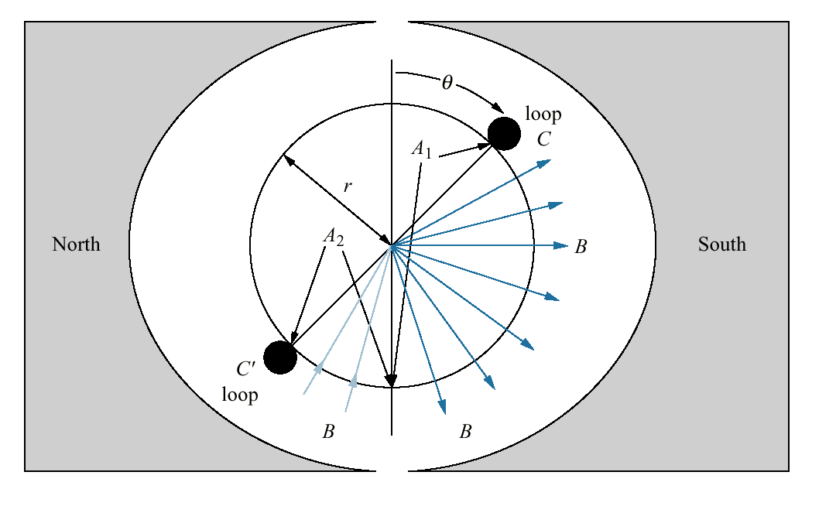
Figure F.3
Magnetic flux density
passing through a loop
of wire on an armature

Slide 5
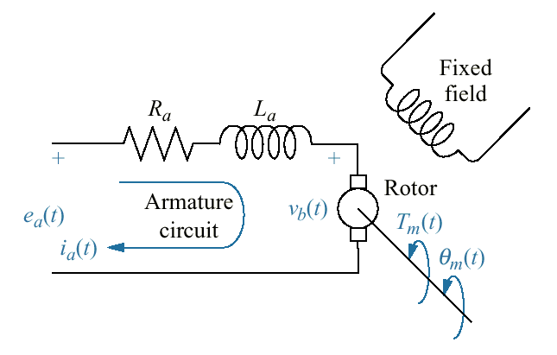
Figure F.4
DC motor circuit
diagram

